Slide 1
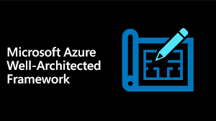

Azure Well Architected Design Considerations BY SHAN -CloudOps

Slide 2

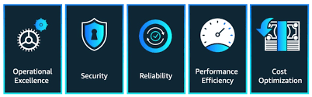
Key Pillars of Azure Well Architect Frameworks

Slide 3



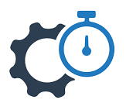

Framework Supporting Elements
Azure Well-Architected Review
Azure Well-Architected Framework
Azure Advisor
Reliability
Cost Optimization
Azure Well-Architected Framework
Operational Excellence
Performance Efficiency
Reference Architectures
Documentation
Security
Partner Support & Services Offer

Slide 4

Reliability
- Ability of system to recover from failure and continue to function.

Slide 5

Overview of Reliability

Slide 6
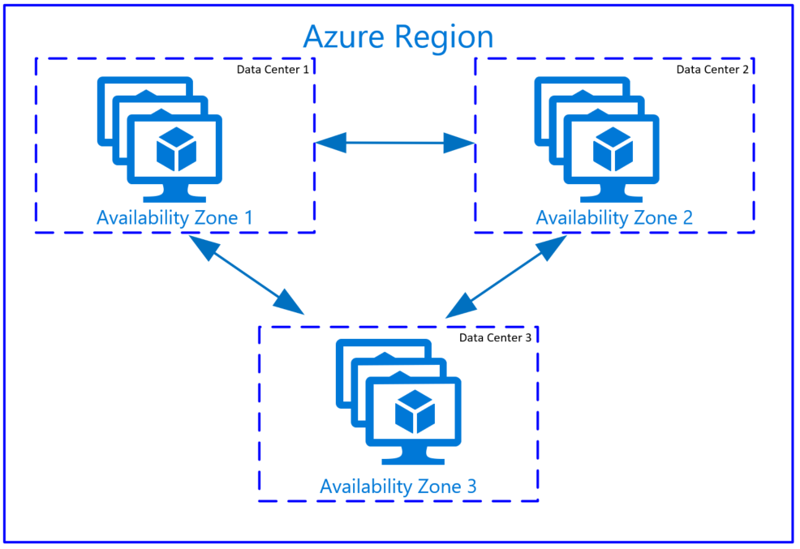


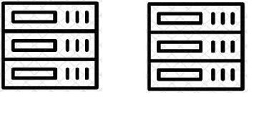
Premium Storage
Availability Sets
Availability Zones
Azure Site Recovery/Region Pairs
SSD /Ultra Storage Options
Fault Domains/ Update Domains
Zones Enablement's
Active – Active / Active –Passive Mode
Single VM
Datacentre
Region
Region 1
Region 2
Isolated VM Failure.
e.g. OS Disk HDD issue
Hardware Failure.
e.g. Server rack issue
Entire datacentre failure
e.g. Power/network/cooling issues
Entire Region failure
e.g. natural disaster scenarios

Slide 7
Security
- Protecting applications and data from threats.

Slide 8

Overview of Cloud Security Pillars

Slide 9
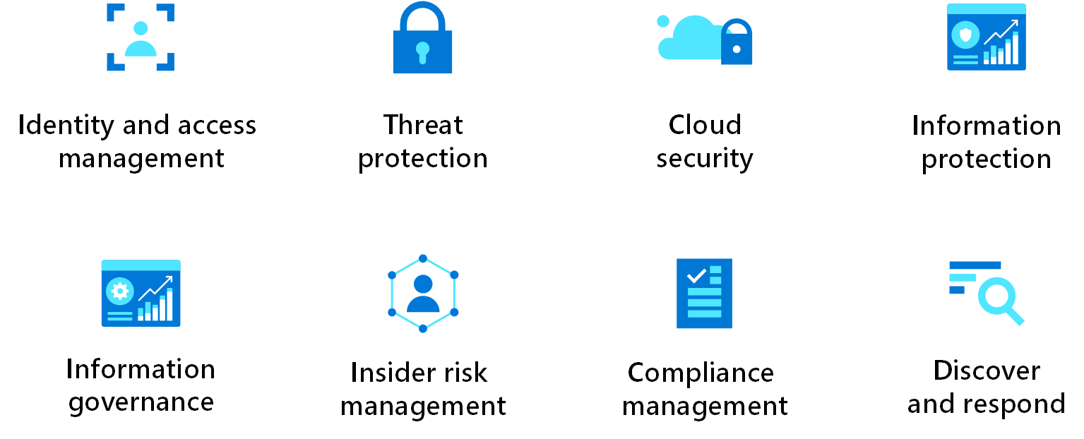

Slide 10
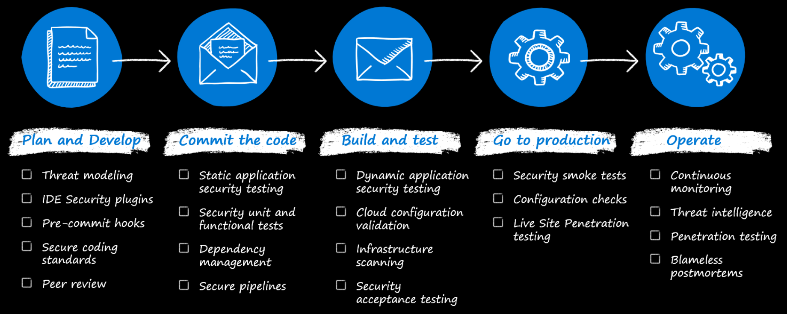
Key Consideration

Slide 11
Cost Optimization
- Managing costs to maximize the value delivered.

Slide 12

Cost Optimization Stages

Slide 13
Design
Provision
Monitor
Optimize
Developing, Conceptualize the Business Needs.
Developing the Building Blocks
Formalizing the Post Production Effects and Support Models
More Cost Effective and Delivering the Products with continuous Feedbacks

Slide 14

Key Best Practises

Slide 15

Increase Cost Awareness
Budgets
Alerts
Tagging
Eliminate cloud waste
Modernize architecture
Shutdown unused resources
Right size underutilized resources
Autoscaling and auto shutdown
Explore PaaS and Serverless
Take advantages of offer
Hybrid Benefits.
Reservation

Slide 16

Operational Excellence

Slide 17



Application Running in Production
Deployment Reliable and Predictable
Fast and Routine Deployment Process

Slide 18

Best Practises

Slide 19
Application Design
Monitoring
Application Performance Management
Code Deployment
Infrastructure Provisioning
Testing

Slide 20

Performance Efficiency

Slide 21


System to meets the Customer Demands efficiently
Scaling the System Appropriately

Slide 22
Best Practises

Slide 23


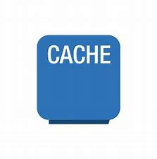
Autoscaling
Background Jobs
Caching

Slide 24
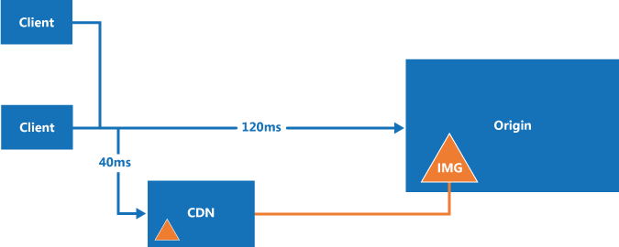
Content Delivery Network

Slide 25
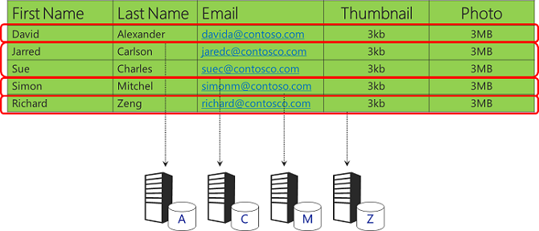
Data Partitioning

Slide 26

Thank You. Subscribe to SHAN CloudOps

